Slide 1
I. Assess learners need
醫學教育部 黃如薏醫師 104.7.27

Slide 2
I. Objectives for assess learners need
At the end of this workshop, participants will:
Describe challenges faced by IMS and the impact on their learning
List different approaches and tools useful in helping determine learner needs

Slide 3
Why Is It Important to Assess the IMS Learning Needs?
Teachers’ usual assumptions about international medical students may not hold true.
Time efficiency!
Notes:
It is always important to assess our learner’s needs, but it is particularly important to do so when working with an IMG.
IMGs come from such diverse educational and cultural backgrounds that the assumptions that teachers automatically make about their learners may not be applicable here. Of course, it is important to take an individual approach with each learner, but particularly so with IMGs. IMG learners are so diverse that their needs are often quite unpredictable to teachers used to working in the Canadian setting. By taking the time to assess learner needs initially, the teacher can provide efficient and focused teaching and avoid wasting time and energy through misinterpretations and false assumptions about the learner.

Slide 4
What to assess?
Personal loss
Previous training
Cultural differences
Knowledge base, clinical skills
Notes:
It is vital to acknowledge the losses the IMG may have suffered in their personal journey, and it is therefore important to hear their story. There has often been much sacrifice, many losses (status, position, financial and material), and a history of menial jobs for IMGs who were previously physicians and are now junior trainees.
The IMG’s previous medical training may have been very different from the Canadian system and teachers cannot assume the homogeneity of North American medical training. It may be helpful to ask them to create a portfolio to showcase their previous accomplishments. Cultural differences also abound, which impact not only on the IMGs’ clinical care of patients and interaction with the health care team, but also their interactions with teachers. (At this point, it may be helpful to elicit examples from the participants. The “empty bullets” are intended to elicit participants’ suggestions.)
The knowledge base of IMGs may be variable. Some IMGs have an excellent knowledge base and clinical skills; others may have lost many of their skills through extended absence from clinical work; others may not have been given the opportunity to gain these skills in the first place.

Slide 5
From an IMG’s Story… personal loss
“I felt small and insignificant. I felt like a number. I felt angry. I was lonely, frustrated and angry. I felt locked out of society. I felt that I was contributing nothing.”
“The IMG Experience” (Appendix H)
Notes:
This is a quote from an IMG’s narrative, describing her feelings soon after her arrival in Canada. She found herself unable to work, and had difficulty finding information about how to begin the process to be able to get licensed as a physician. Despite having worked for many years in her own country, and knowing that there was a serious shortage of physicians where she was living now, she was still experiencing these hardships. (This quote is taken from Narrative 2, “The IMG Experience” in Appendix H.)
Life altering experience
Family and financing diffuculties

Slide 6
Areas of Potential Strength – previous training
Depth of clinical experience
Familiarity with less commonly seen conditions
Clinically skilled – less reliance on diagnostics
Professionally mature
Notes:
Areas which have been identified as strengths for some IMGs include their clinical experience and experience with diseases and conditions not often seen in this country. Many have developed finely honed clinical skills because they have not had as ready an access to diagnostic testing.
The diverse cultural make-up of the Canadian population means that physicians from a similar background are often a welcome addition to a community; their ability to provide care in a person’s native language, and an understanding of their culture, are often valued. (Again, the “empty bullet” is intended to elicit participants’ ideas.)

Slide 7
Areas of Potential Need – cultural differences
History-taking in some areas (sexual, psychosocial areas)
Patient-centered care and partnership
Ethical decision-making
Evidence-based medicine
Notes:
Language, discrimination, culture norm, sex-role
Some of the medical literature on IMGs has identified areas of more common need. However, it is important to recognize that there is great diversity among IMGs.
These identified areas are notably fraught with cultural issues, or in the case of evidence-based medicine, may not have been taught in the IMG’s medical school at the time of their original training.
Unfamiliarity with cultural acceptable ways of presenting and illness.

Slide 8
Assessing Tips
Take time to understand the IMG’s personal story
Clarify previous experiences
Work to gain an understanding of cultural differences for the IMG
Assess incoming knowledge and skills systematically
Notes:
Investing time at the beginning of the relationship is well worth it. Later in this workshop, there will be more discussion on some of the tools that can be used to help the teacher understand the IMG’s story and personal journey. Doing so is an invaluable way to understand and anticipate the learning needs of the IMG.
One of the difficulties with cultural differences is that we all make so many assumptions, without even being aware of them. The module “Educating for Cultural Awareness” deals with this extensively, but briefly, it is important for all teachers of IMGs to be aware of their own assumptions and to consider that some of the behaviour that they see in the IMG may be culturally determined. Open discussion will help to clarify what is happening.
Clarifying previous clinical experience and being systematic about assessing the knowledge and skill that the IMG brings to the clinical placement or educational program is necessary to provide the information needed to properly assess the learning needs of the IMG.
了解這些可能是很花時間 以下介紹一些可以在日常生活中運用來ALN的技巧

Slide 9
Strategies for Assessing Learning Needs
Assessing learner needs must be an ongoing process
Multiple assessments done across a variety of dimensions provide the best information
Assessing learner needs can save time in the long run
Notes:
It is well understood that the needs of a learner are dynamic and ever-changing, and that the most accurate assessments come from multiple samplings over a variety of dimensions at different times. Hence, it would be important to formally consider the learner’s needs at the start of a clinical placement and mid-way through. Also, routine checks are recommended, as clinical cases arise, to determine whether the learner has needs in particular knowledge domains.
It is also important to establish follow-up plans to revisit goals and the progress towards meeting them.
Teachers may raise concerns that this is very time consuming. However, stepping back to thoughtfully assess the learning needs of the IMG can save time in the long run, much as thoroughly assessing a patient does before ordering tests and prescribing treatment.

Slide 10
Strategies for Assessing Learning Needs
Teachers need to create a safe learning environment
* the major goal of the teacher may be for the IMG to be an excellent clinician
Teachers should role model self-assessment and self-reflection
Use tools such as portfolios which the IMG can develop and maintain
Notes:
It is important for the IMG to feel safe enough to reveal his or her learning needs. This is difficult enough in the Canadian training environment, but many IMGs have been through very difficult experiences just to get where they are, and their initial training may not have been one which allowed for the acknowledgement of weakness. Hence, teachers must go out of their way to make IMG learners feel safe enough to acknowledge their areas of need. (Ask the group how they might do this with their learners.)
Teachers can do this, in part, by role modeling self assessment and self-reflection, and the normalcy of recognizing personal learning needs.
One additional note about creating a safe learning environment: It is important to be honest about the purpose and the outcomes of any assessment, so that the IMG understands what is at stake and what is not. For example, the major goal of the teacher may be for the IMG to be an excellent clinician and pass the licensing exams – or it may be to see if the IMG is meeting the standards necessary to enter into the training program in the first place. This module is geared towards the teacher whose purpose is the first goal, though the IMG may not be fully trusting of that goal.
Portfolios are collections of materials which reflect a learner’s professional experience and education. They may be helpful in understanding the IMG’s potential areas of strength and learning needs. Narratives can also be useful. These are stories, written in the first person, that describe the experiences of IMGs.

Slide 11
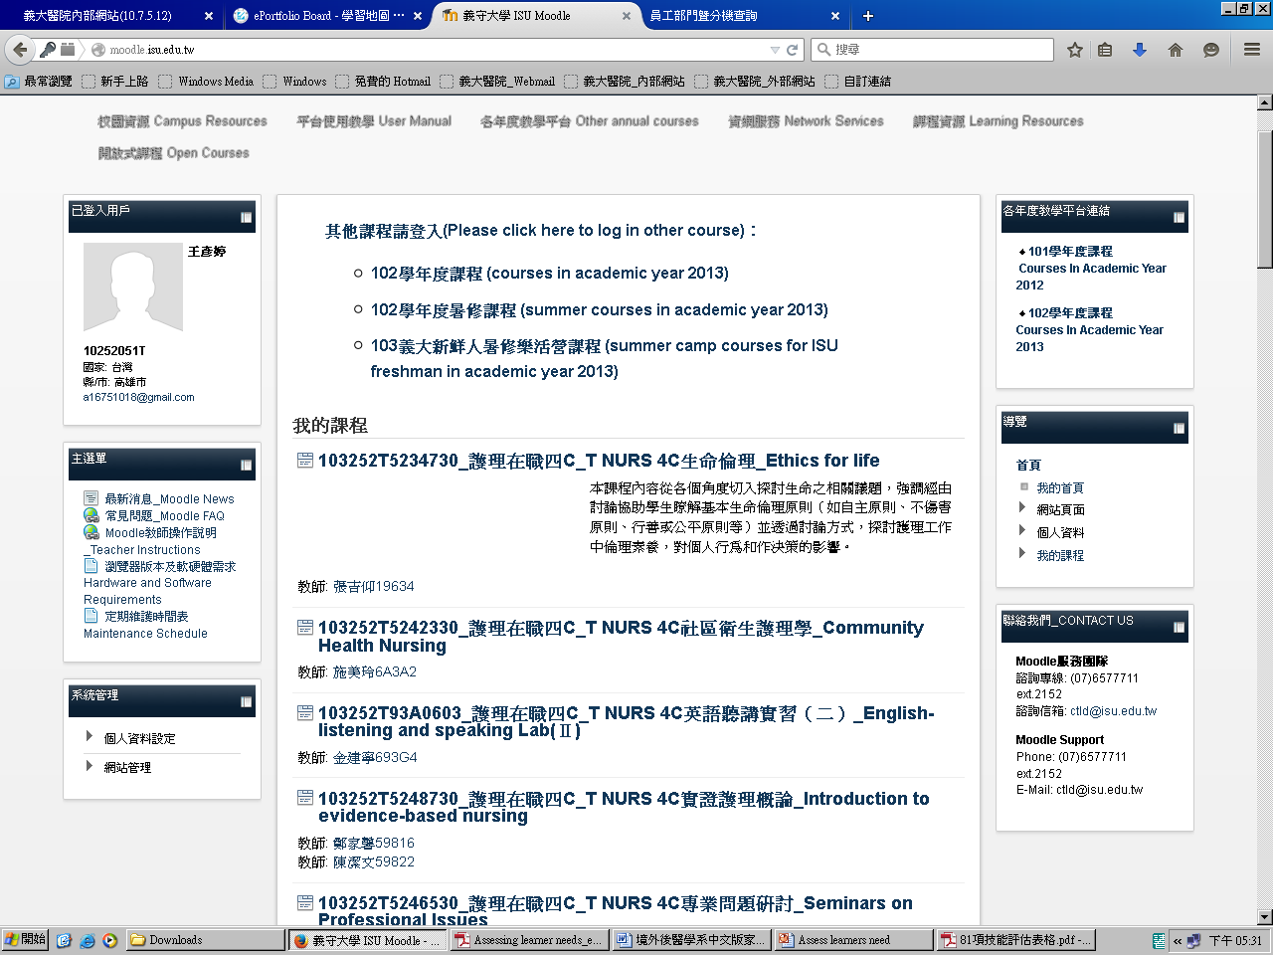

Slide 12
Teaching Tips
Make the purpose of the assessment clear
Ask for self-assessment - teach and model how to do it
Use an iterative process
Establish follow-up plans
Respect and allow for cultural differences
Be aware of common issues for IMGs
Notes:
(This slide reviews and summarizes material covered in the earlier slides.)

Slide 13
Let’s talk…
With a 33 year-old woman from Saint Lucia, previously a nurse in the national hospital, live in Taiwan for 2 years…
A: Teacher
B: International student
C: Observer
10 min for this session
(Video Scenario 5)
Notes:
(At this time, the group should stop and consider Video Scenario #5. This is available on video (on the CD at the end of the program), and also as a role play script in Appendix G.)
This practice session is focused on talking with the IMG about their personal story. This can be done best through a role play. The video can be used in the large group to give the participants a sense of the IMG learner in the scenario. The group can then be broken down into smaller groups to role play a discussion between the teacher and the IMG about her past experiences.
Alternatively the entire group can engage in a discussion about the importance of understanding her background, and the kinds of methods that would be most useful. If preferred, the role play script can be used for participants, or the facilitator may play the part of the IMG learner instead of using the video. Appendix C, an interview structure for exploring previous learning and practice experience may be a helpful guide for participants.
(Full instructions for setting up this part of the workshop are found in Appendix D, the Workshop Outline.)

Slide 14
Establishing Mutual Expectations
“Preceptors must clarify their common expectations on a routine basis so that we don’t end up in trouble for not doing things that we didn’t know we were supposed to do.”
Armson, 2003
Notes:
As has been mentioned earlier, medical teachers have often been working in the Canadian health care system for long periods of time, and many have known no other system. Because of this, there are a number of common policies and procedures which are taken for granted by teachers but which are neither understood nor known by those who come from outside the system. It is important to step back and clarify to the IMG learner just what those things are.
Some examples include policies around reporting back after seeing a patient, either an inpatient or an outpatient. We may take it for granted that a learner will know exactly what is allowed before reporting back, and this is worth discussing from the outset.

Slide 15
What Are YOUR Clinical Expectations of Your Learners?
Notes:
We often have ingrained assumptions about what our learners should do based on our own training and experiences, and we do not think to make this explicit to those who are coming from a completely different system.
(Ask the participants for examples of unwritten policies from their own teaching situation which might need to be made explicit to IMGs. A group discussion about the implicit expectations we have of our learners can evolve from this slide. Appendix A lists some common areas which can be reviewed with an IMG learner, and this may be a useful handout.)

Slide 16
Teaching Tips
Establish clinical and educational expectations of the IMG
Establish the role of the teacher
Use syllabus
Hold regular meetings to review progress
Document with learning plans, progress notes
Notes:
It is also important to be clear about the role of the teacher.
Written material and checklists can help to ensure that the necessary material is covered systematically and can be referred to later if necessary.
On-going informal discussions are important, but it is vital that there be regular meetings between the IMG and his or her direct supervisor to discuss expectations, set learning goals, and plan educational activities to meet these goals. Documentation of these meetings will serve as a map for teaching and learning activities, and as a useful reference in the future. Such a systematic approach may be new to some IMGs and may require some explanation
This is all leading up to the development of a learning agreement or plan.

Slide 17
Tailoring Teaching Programs
The existing programs may have to be modified for an individual IMG
And better to do it in advance…
Identify resources in advance to prepare the learner for the placement
* Independent readings, seminars and courses, self-directed learning modules, clinical skills labs, standardized patients, simulation tests.
Notes:
The next step is to use this information to adapt the educational experience of the IMG. The training program may have existing clinical placements which are well suited to meet these learning needs, or new ones may need to be identified.
It is wise to identify the need in advance rather than to discover that a problem has developed because the IMG is performing differently from other Canadian-trained learners. This might include highlighting areas which require additional supervision, e.g. clinical skill, clinical exposures which need to be augmented, or issues of time management.
It can be very helpful to identify resources which the IMG can use to prepare for an upcoming clinical placement. This includes independent readings, seminars and courses, and self-directed learning modules such as those offered by the College of Family Physicians of Canada. Some programs may also have access to clinical skills labs, standardized patients, and other learning resources.

Slide 18
A Good Learning Plan is…? Discuss with your neighbor for 2-3 minutes
Notes:
(A buzz group may be an appropriate strategy at this point in the workshop. Before going beyond the title on the slide, ask participants to turn to the person beside them, and discuss for 2-3 minutes what they think the components of a good learning plan would be. At the end of the time, call the group to order, and ask them for their ideas. They will come up with ideas similar to what is on the slide, and probably some additional ideas. Then reveal the bullets on the slide, and discuss any that haven’t already been raised. Many programs will have a standard form which can be used to formalize this activity, but if not, there is a sample in Appendix B which can be used as an example for this session.)

Slide 19
Learning Plans
Articulate specific goals and strategies
Include both teacher and learner goals
Connect goals to methods for achievement
Outline the timeline
List evaluation methods
Describe evaluation criteria
Notes:
(A buzz group may be an appropriate strategy at this point in the workshop. Before going beyond the title on the slide, ask participants to turn to the person beside them, and discuss for 2-3 minutes what they think the components of a good learning plan would be. At the end of the time, call the group to order, and ask them for their ideas. They will come up with ideas similar to what is on the slide, and probably some additional ideas. Then reveal the bullets on the slide, and discuss any that haven’t already been raised. Many programs will have a standard form which can be used to formalize this activity, but if not, there is a sample in Appendix B which can be used as an example for this session.)

Slide 20
Teaching Tips
Ensure that the learning program is built on clearly defined objectives
Plan ahead to make any necessary modifications to the placement
Be creative to supplement the clinical experience

Slide 21
You Are Meeting With an IMG…
To discuss and agree on a learning plan…
A: Teacher
B: International student
C: Observer
10 min for this session
Notes:
(This slide is the introduction to the practice session as outlined in Appendix D, the workshop outline. Materials needed include the scripts in Appendix G, which describe several IMG learners, and the outline of a learning plan, Appendix B. The purpose of the session will be for participants to have an opportunity to work through the development of a learning agreement with an IMG.)

Slide 22
In Summary
Understand the IMG’s incoming experiences
Assess needs iteratively in multiple domains
Clarify roles and expectations
Customize learning experiences
Portfolios, narratives, discussions
Planned review times & “on the fly” teaching
Discussion, written learning plan
Self study, readings, modified rotations
Notes:
(This slide provides a brief overview of the approach outlined in this session. The left hand column outlines the steps, while the right hand column briefly highlights some of the tools that can be used.)

